Slide 1
Demolish Plastic Packings!
Kengo Tamura, Kent Isa, Tomoharu Koga

Slide 2
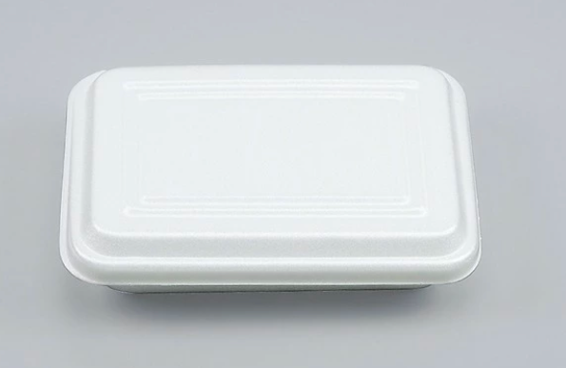
1. Problem (1)
Our school cafeteria used pottery for our lunch.
However, because of COVID-19, they start using plastic packings.

Slide 3
1. Problem (2)
When we use plastic packings for our lunch,
1) A lot of microplastics are generated. These microplastics will hurt the ecosystem.
2) We will eat many microplastics.

Slide 4
1. Problem (3)
If we use plastic packings for our lunch…
10(g) x 3(packs at once)
x 500(students) x 200(days) = 3000(kg)
of plastic will be used.

Slide 5
Message:
Stop eating plastic,
stop hurting the ecosystem.

Slide 6
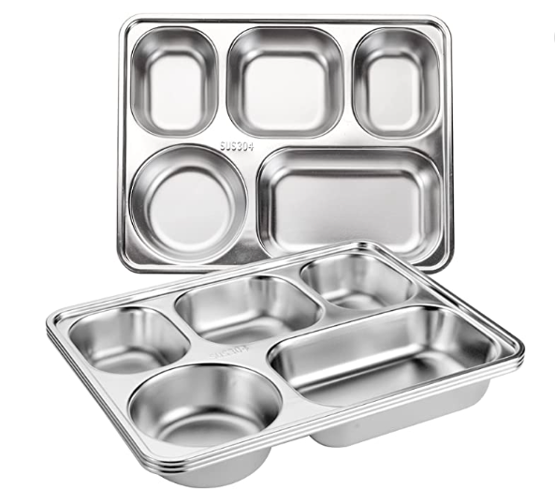
2. Solution (1)
We should use stainless plates instead of plastic packings.

Slide 7
2. Solution (2)
If we use this korean type plate, we don’t have to use many plates, so we can reduce washing cost. It also means we can reduce water.
We have to buy stainless bowl for noodles.

Slide 8
3. Audience
We have to suggest it to our school cafeteria and our school.
We think that it is good to suggest it from the school council.

Slide 9
4. Practicability (1)
The cost of stainless plates
994.9(yen) x 200(plates) + 1,060(yen) x 200(bowls)
+ 2,700(yen) / 2000(plates) x 500(plates/day) x 2,000(days)
…(washing cost) = 1,760,980(yen/10year)
Source
Stainless Korean Plate (https://www.amazon.com/s?k=Korean+lunch+plate&ref=nb_sb_noss)
Stainless Bowl (https://www.amazon.com/s?k=Stainless+bowl&crid=541725NCLPEO&sprefix=stainless+bowl%2Caps%2C289&ref=nb_sb_noss_1,
https://search.rakuten.co.jp/search/mall/%E3%81%A9%E3%82%93%E3%81%B6%E3%82%8A+%E3%82%B9%E3%83%86%E3%83%B3%E3%83%AC%E3%82%B9/)
Washing cost (https://panasonic.biz/appliance/cold_chain/dishwasher/merit.html)

Slide 10
4. Practicability (2)
Washing cost of stainless plates
Because of COVID-19, we have to make sure that the plates are clean and sterilize.
If we use pottery, washing many plates at once is difficult because we can’t use chemical soap and heat.

Slide 11

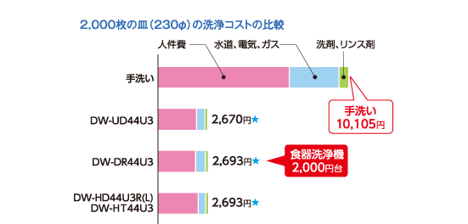
4. Practicability (3)
According to this website, washing cost is about
2,700(yen) / 2,000 plates.
https://panasonic.biz/appliance/cold_chain/dishwasher/merit.html

Slide 12
4. Practicability (4)
The cost of plastic packings
9.655(yen) x 3(packs at once) x 500(students/day)
x 2000(days) = 28,965,000(yen/10year)
Source
https://search.rakuten.co.jp/search/mall/%E6%A5%AD%E5%8B%99%E7%94%A8+%E7%99%BA%E6%B3%A1+%E5%BC%81%E5%BD%93%E7%AE%B1/

Slide 13
4. Practicability (5)
The cost of stainless plates 1,760,980(yen/10year)
The cost of plastic packings 28,965,000(yen/10year)

Slide 14
4. Practicability (6)
Why stainless?
COVID-19
It is more reasonable than aluminum plate.
If we use paper plates, it will not be recycled, so we have to burn it. Then, a lot of CO2 will be emited.

Slide 15
5. Digital media vs Analog media
The audiences are Japanese company and school, so they require a paper document.
So, we have to print our opinion.
It costs only 20 yen to submit it to our school and our school cafeteria company.

